Slide 1
Engineering Physics: (01GS1101) Digital Electronics
Mr Dhaiwat Trivedi
Assistant Professor,
Mechanical Engineering Department,
Marwadi University, Rajkot

Slide 2
Contents
Unit-5: Digital electronics
Introduction – Logic levels – Basic logic gates: OR, AND , NOT gates – Universal logic gates : NAND and NOR gates – Symbolic representation, Boolean expression and Truth table for all above logic gates, Integrated circuits– Levels of integration – SSI, MSI, LSI and VLSI - Advantages of ICs.

Slide 3
Digital Electronics
It is field of Electronics which deals with Digital Signals.
The signal which is processed or generated using the electronic circuit are digital in nature.
Digital Circuits are used in diverse applications such as CD Players; Smartphones; TV’s, Computers etc.

Slide 4
Introduction
Basically there are two different type of signals
- Analog and Digital
Continuously varying signal is called analog signal.
Output voltage changes continuously according to input variation.
Output voltage can have infinite number of values.
A signal which have two discrete value is called digital signals. For example, a square wave is a digital signal
Known as high – low, or on – off, or, saturation – cutoff, or, one – zero.
An electronic circuit that is desgined for two state operation is called digital circuit.
The branch which deals with the digital circuit is called Digital Electroncs.

Slide 5
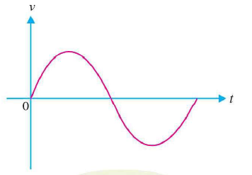
Introduction
Analog signal: Ex: Alternating current varying sinusoidally is an analog signal.
This is the analog operation that is the output voltage can have an infinite number of values, due to this the analog operation is less reliable.

Slide 6
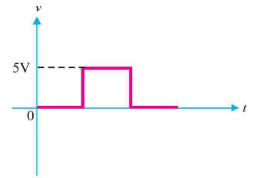
Introduction
Digital Signal: Ex: Square wave is digital signal.. It is because the signal have only two values +5V and 0V.
This values are labled as High and Low.
If the proper digital signal is given to transistor, it driven between cutoff and saturation.
Transistor have two state of operation i.e. Output is either high or low.
The digtal circuit is one that it express the values in digits hence the name Digital

Slide 7
Advantages of Digital electronics
Digital data is easy to store
More accurate and reliable than analog system.
Easy to fabricate digital circuits.
Easily scalable.

Slide 8
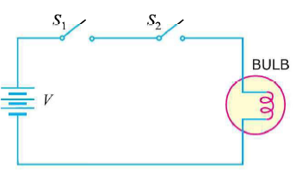
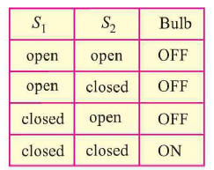
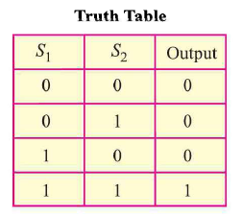
Introduction
A digital circuit which have one or more input but only have one output signal is called logic gate.
Fig. shows switching circuit its output can have only on of the two possible states. Either high voltage (1) or low voltage (0).
This the basic idea of logic gate using switches.
The term logic is usually used to refer the decision making process
A logic gate makes logical decision regarding output based on the input given to it.
Hence such circuit called logical circuit.

Slide 9
Introduction
A logic gate is a device that acts as a building block for digital circuits.
They perform basic logical functions that are fundamental to digital circuits.
Most electronic devices we use today will have some form of logic gates in them.
For example, logic gates can be used in technologies such as smartphones, tablets or within memory devices.

Slide 10
Introduction
In a circuit, logic gates will make decisions based on a combination of digital signals coming from its inputs.
Logic gates are based on Boolean algebra.
At any given moment, every terminal is in one of the two binary conditions, false or true.
False represents 0, and true represents 1.
Depending on the type of logic gate being used and the combination of inputs, the binary output will differ.
Logic gates are commonly used in integrated circuits (IC).
Basic logic gates - There are seven basic logic gates:
AND, OR, XOR, NOT, NAND, NOR, and XNOR.

Slide 11
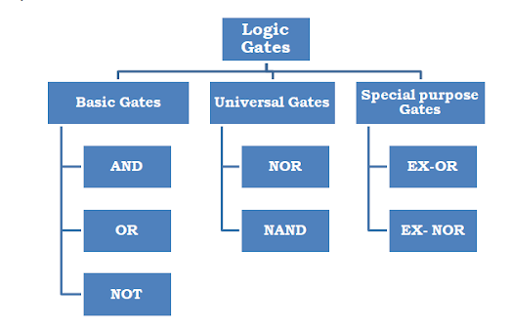
Types of Logic Gates

Slide 12
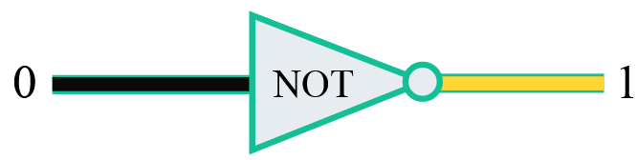
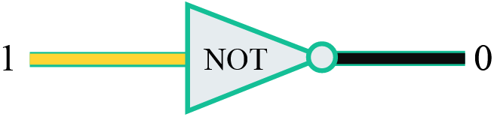
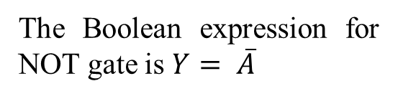
Logic Gate
The three basic logic gates that make up all digital circuits are
1. NOT gate 2. AND gate and 3. OR gate
The simplest gate is the NOT gate, also known as an inverter. It accepts a single input and outputs the opposite value.
If the input is 0, the output is 1 : -
If the input is 1, the output is 0 : -
Input | Output
0 | 1
1 | 0
The Boolean expression for NOT gate is $Y= \overline{A}$

Slide 13

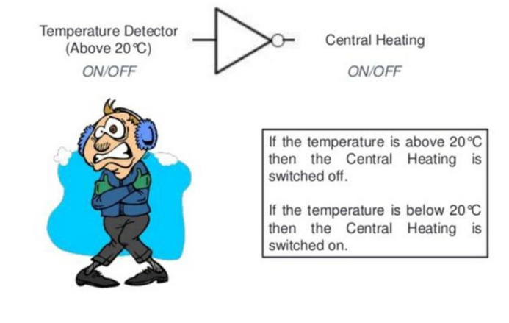
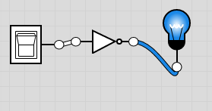
NOT Gate circuit

Slide 14
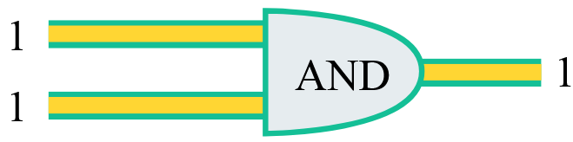
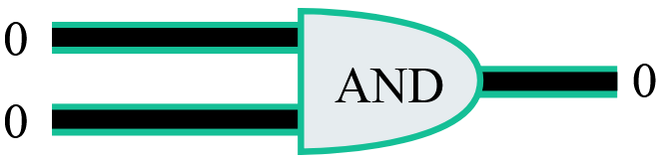
AND Gate
All other logic gates operate on multiple inputs.
The AND gate accepts two wires, and if both of those wires are "on" (representing 1), it outputs 1.
If either of those wires are "off" (representing 0), then it outputs 0:

Slide 15
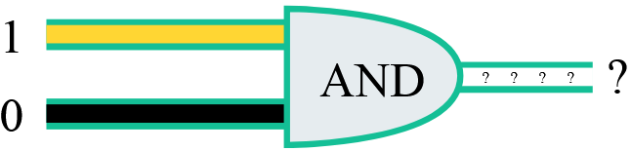
AND Gate
What do you think about this combination ?
AND is a Boolean operation, an operation that takes values that are either "true" or "false", and then outputs "true" or "false" based on a logical manipulation of those inputs.
In logic gates, we consider 1 to be true and 0 to be false.

Slide 16
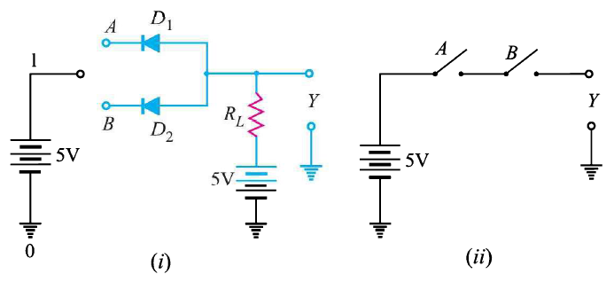
AND Gate circuit.

Slide 17
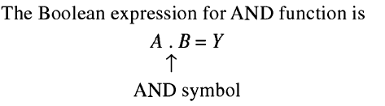
AND Gate
One way to understand Boolean operations is to make a truth table of all the possible inputs and outputs. Here's a truth table for the AND gate:
Input A | Input B
0 | 0
1 | 0
0 | 1
1 | 1
Output Y
0
0
0
1

Slide 18
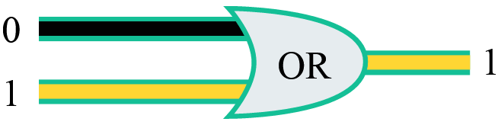
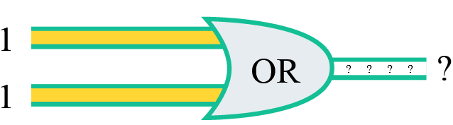
OR Gate
The OR logic gate accepts two inputs, and as long as either of those inputs is a 1, it outputs a 1:
Based on that description, what value do you think this OR gate outputs?

Slide 19
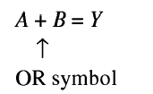
OR Gate
One way to understand Boolean operations is to make a truth table of all the possible inputs and outputs. Here's a truth table for the AND gate:
The output is a 1 for every row except one. The only time that an OR gate outputs a 0 is if both inputs are 0.
Input A | Input B
0 | 0
1 | 0
0 | 1
1 | 1
Output
0
1
1
1

Slide 20
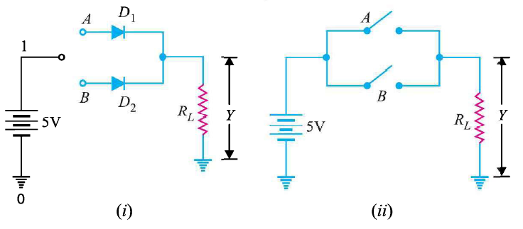
OR Gate using Diode.

Slide 21
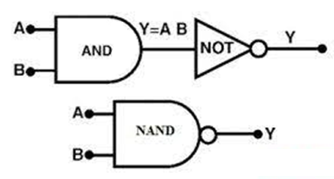

NAND Gate
The NAND gate operates as an AND gate followed by a NOT gate. It acts in the manner of the logical operation "and" followed by negation.
The output is "false" if both inputs are "true." Otherwise, the output is "true."
Input A | Input B | Output
1 | 1 | 0
1 | 0 | 1
0 | 1 | 1
0 | 0 | 1

Slide 22
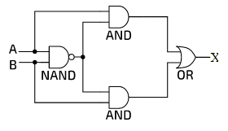
NAND Gate
The circuit diagram below shows a combination of four logic gates: a NAND, two ANDs and an OR. A and B are the inputs, which can each have values of either 0,0 or 1,1. X is the output.
Input A | Input B | Output
1 | 1
1 | 0
0 | 1
0 | 0

Slide 23
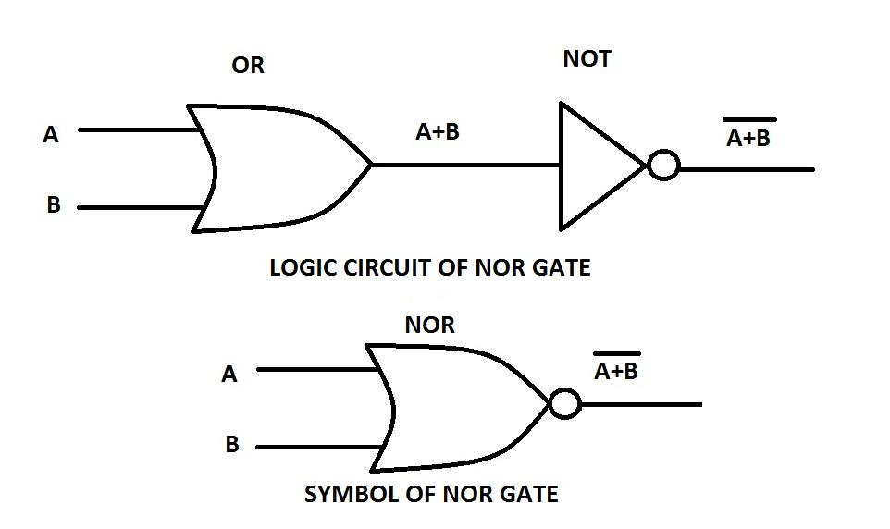

NOR Gate
The NOR gate is a combination OR gate followed by an inverter. Its output is "true" if both inputs are "false." Otherwise, the output is "false.“
Input A | Input B | Output
1 | 1 | 0
1 | 0 | 0
0 | 1 | 0
0 | 0 | 1

Slide 24
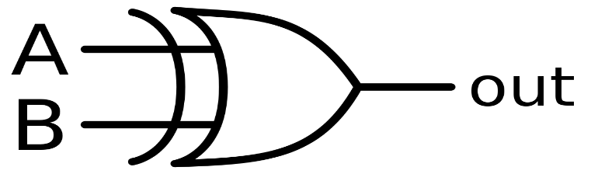
X-OR Gate
The XOR ( exclusive-OR ) gate acts in the same way as the logical "either/or."
The output is "true" if either, but not both, of the inputs are "true."
The output is "false" if both inputs are "false" or if both inputs are "true."
Another way of looking at this circuit is to observe that the output is 1 if the inputs are different, but 0 if the inputs are the same.
Input A | Input B | Output
1 | 1 | 0
1 | 0 | 1
0 | 1 | 1
0 | 0 | 0

Slide 25
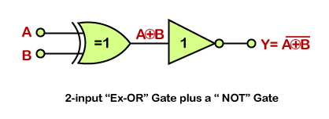
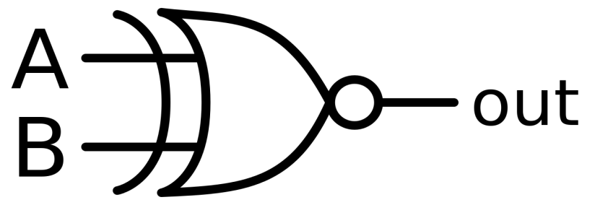
X-NOR Gate
The XNOR (exclusive-NOR) gate is a combination XOR gate followed by an inverter.
Its output is "true" if the inputs are the same, and "false" if the inputs are different.
Input A | Input B | Output
1 | 1 | 1
1 | 0 | 0
0 | 1 | 0
0 | 0 | 1

Slide 26
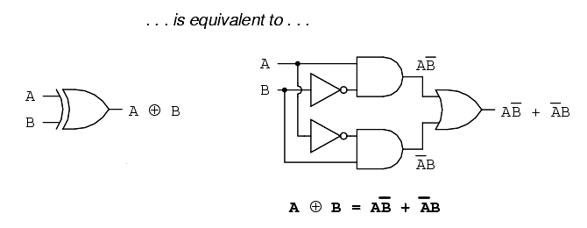
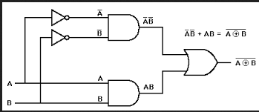

X-NOR Gate

Slide 27
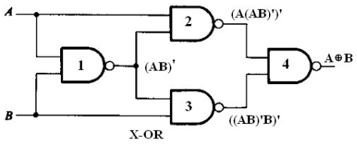

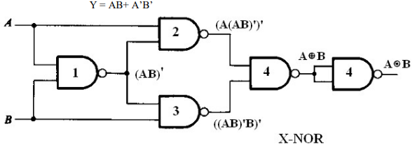
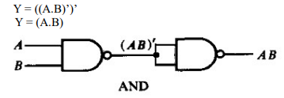
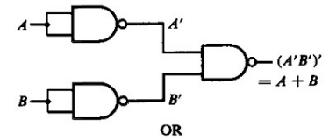
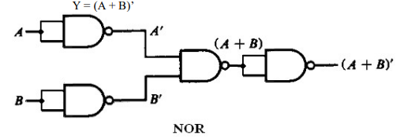
NAND Gate

Slide 28
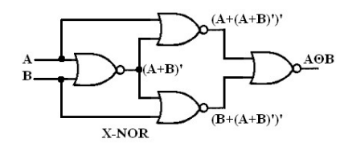

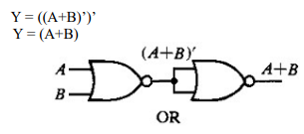
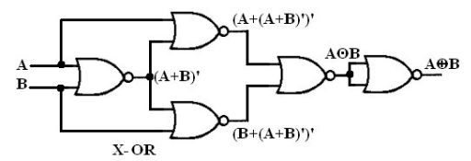
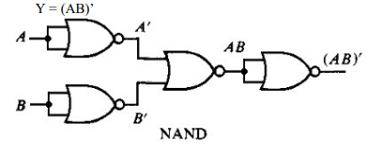
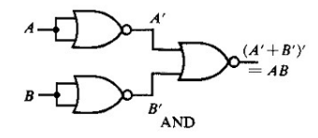
NOR Gate

Slide 29
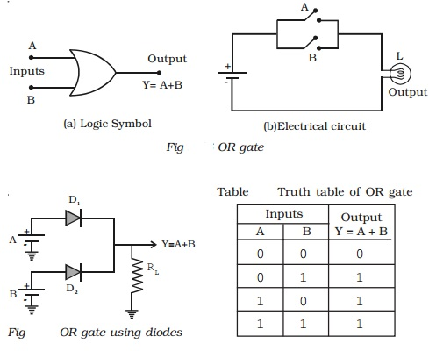
OR Gate using Diode

Slide 30
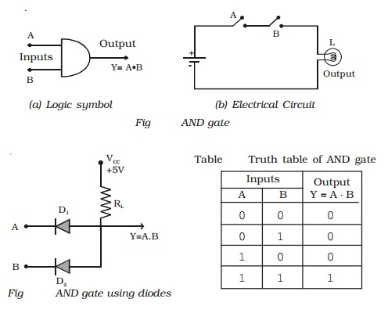
AND Gate using Diode

Slide 31
Applications of Logic Gates
NOT – Inverter
AND - digital measuring devices, alarm circuits, Automatic temperature-regulating circuits, Freezer warning buzzer devices.
OR – automatic digital control circuits, Implemented in alarm systems and intrusion detection equipment, Used in industrial plants for some protective measures.
NAND - Burglar alarm or theft alarm, push button switches like Door Bell, functioning of street lights,
XNOR - error detecting circuits which are to detect Odd parity or even parity bits in digital data transmission circuits. XNOR gate is mainly used in arithmetic and encryption circuits.

Slide 32
Combinations of Logic Gates
Degenerative Form:
If the output of two-level logic realization can be obtained by using a single Logic gate, then it is known as degenerative form.
AND-AND, AND-NAND, OR-OR, OR-NOR, NAND-NOR, NOR-NAND.
Non-degenerative Form:
If the output of two-level logic realization can’t be obtained by using a single logic gate, then it is known as a non-degenerative form.
AND-OR, AND-NOR, OR-AND, OR-NAND, NAND-AND, NANDOR, NAND-NAND, NOR-AND, NOR-OR, NOR-NOR

Slide 33
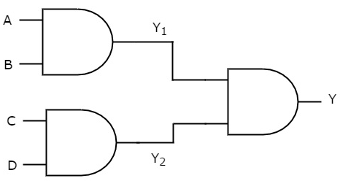
Combinations of Logic Gates
AND-AND Logic:
We will get the outputs of first-level logic gates as Y₁ = AB and Y₂ = CD
These outputs, Y₁ and Y₂ are applied as inputs of AND gate that is present in the second level.
So, the output of this AND gate is Y = Y₁ Y₂
So, Y = (AB) (CD)

Slide 34
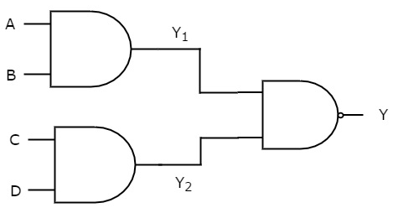
Combinations of Logic Gates
AND-NAND Logic:
We will get the outputs of first-level logic gates as Y₁ = AB and Y₂ = CD
These outputs, Y₁ and Y₂ are applied as inputs of NAND gate that is present in the second level.
So, the output of this NAND gate is Y = Y₁ Y₂
So, Y = (AB) (CD)

Slide 35
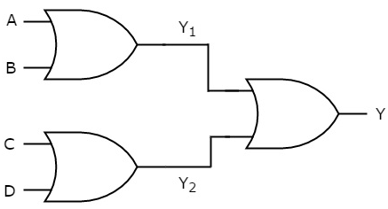
Combinations of Logic Gates
OR-OR Logic:
We will get the outputs of first-level logic gates as Y₁ = A + B and Y₂ = C + D
These outputs, Y₁ and Y₂ are applied as inputs of OR gate that is present in the second level.
So, the output of this OR gate is Y = Y₁ + Y₂
So, Y = (A + B) + (C + D)

Slide 36
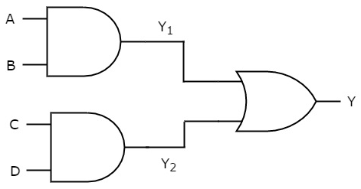
Combinations of Logic Gates
AND-OR Logic:
We will get the outputs of first-level logic gates as Y₁ = AB and Y₂ = CD
These outputs, Y₁ and Y₂ are applied as inputs of OR gate that is present in the second level.
So, the output of this OR gate is Y = Y₁ + Y₂
So, Y = (AB) + (CD)
The output of this AND-OR logic realization is AB + CD. This Boolean function is in Sum of Products form.
So, we can’t implement it by using single logic gate, this AND-OR logic realization is a non-degenerative form.

Slide 37
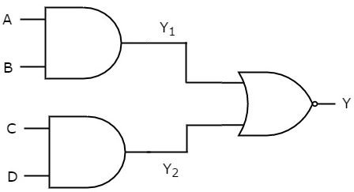
Combinations of Logic Gates
AND-NOR Logic:
We will get the outputs of first-level logic gates as Y₁ = AB and Y₂ = CD
These outputs, Y₁ and Y₂ are applied as inputs of NOR gate that is present in the second level.
So, the output of this NOR gate is Y = Y₁ + Y₂
So, Y = (AB) + (CD)
The output of this AND-NOR logic realization is AB + CD. This Boolean function is in AND-OR-Invert form.
So, we can’t implement it by using single logic gate, this AND-NOR logic realization is a non-degenerative form.

Slide 38
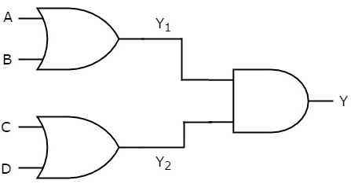
Combinations of Logic Gates
OR-AND Logic:
We will get the outputs of first-level logic gates as Y₁ = A + B and Y₂ = C + D
These outputs, Y₁ and Y₂ are applied as inputs of AND gate that is present in the second level.
So, the output of this AND gate is Y = Y₁ Y₂
So, Y = (A + B) (C + D)
The output of this AND-NOR logic realization is A + B C + D. This Boolean function is in Product of Sums form.
So, we can’t implement it by using single logic gate, this OR-AND logic realization is a non-degenerative form.

Slide 39
Binary Adders
Types of Binary Adders
Half Adders
Full Adders

Slide 40
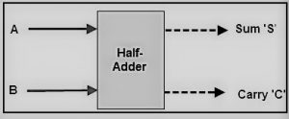

Half Adders
Half adder is a combinational logic circuit with two inputs and two outputs.
It is the basic building block for addition of two “single” bit number.
This circuit has two outputs namely “carry” and “sum”.
To perform the sum operation, XOR is applied to both the inputs, and AND gate is applied to both inputs to produce carry.
Disadvantage: The addition of 3 bits is not possible.

Slide 41
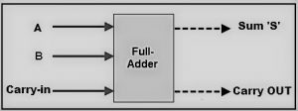
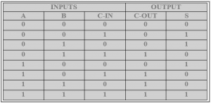
Full Adders
It can add two one-bit numbers A and B, and carry C_{in}. It consist three input and two output.
It is the basic building block for addition of two “single” bit number.
This circuit has two outputs namely “carry” and “sum”.

Slide 42
Full Adders
The SUM ‘S’ is produced in two steps:
By XORing the provided inputs ‘A’ and ‘B’
The result of A XOR B is then XORed with the C-IN
The Carry ‘C’ is produced:
C_{o} = AB + AC_{in} + BC_{in}

Slide 43
Binary Subtractors
Types of Binary Subtractors
Half Subtractors
Full Subtractors

Slide 44
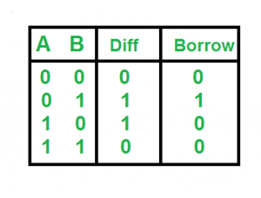

Half Subtractor
It is a combinational circuit with two inputs and two outputs (difference and borrow).
To find difference (D) = A - B, and Borrow (B₀) = A . B
Disadvantage: It can only perform the subtraction of two binary bits. But while performing the subtraction, it does not take into account the borrow of lower stage.

Slide 45


Full Subtractor
It is a combinational circuit with three inputs A,B, and B_{in} and two outputs D and B_{o}.
To find difference (D) = A – B – C_{in}
Borrow (B₀) = A . B_{in} + A . B + B . B_{in}

Slide 46

Difference between half & Full Adders

Slide 47


Integrated Circuits
Integrated Circuits are usually known as Ics.
It is a small chip that can function as an Amplifier, oscillator, timer and Microprocessor or even computer memory.
It is a Small wafer made up of silicon, that can hold million of Transistors, resistors and capacitors.

Slide 48
Integrated Circuits
Classification of Integrated Circuits:
Small Scale Integration or (SSI) – Contain up to 10 transistors or a few gates within a single package such as AND, OR, NOT gates.
Medium Scale Integration or (MSI) – between 10 and 100 transistors or tens of gates within a single package and perform digital operations such as adders, counters and multiplexers.
Large Scale Integration or (LSI) – between 100 and 1,000 transistors or hundreds of gates and perform specific digital operations such as I/O chips, memory, arithmetic and logic units.
Very-Large Scale Integration or (VLSI) – between 1,000 and 10,000 transistors or thousands of gates and perform computational operations such as processors, large memory arrays and programmable logic devices.

Slide 49
Advantages of ICs (Integrated Circuits)
It is more reliable
The entire physical size of IC is the extremely small size
Low power consumption because of their small size
It can easily replace but it can hardly remain in case of failure
It is suitable for small signal operation
Greater ability to operate at extreme temperature
The weight of an IC is very less as compared to entire discrete circuits
Close matching of components because of bulk production in batches
Improved functional performance as some complex circuits can be fabricated for achieving better characteristics
The reduction in power consumption is achieved due to the extremely small size of IC

Slide 50
Disadvantages of ICs (Integrated Circuits)
Complete IC is to be replaced by new one in case of failure
Limited Power rating (Upto 10 W)
Quite delicate in Handling.

Slide 51
Thank You

